Slide 1
PowerShell DSC overview
Igor Shenderchuk
Senior Software Engineer

Slide 2
Agenda
What is DSC?
DSC Architectural Overview
Compilation phase
Execution phase
Staging phase (push and pull modes)
Windows DSC resources
Demo

Slide 3
What is DSC?
“Desired State Configuration is Microsoft’s technology, introduced in Windows management framework 4.0, for declarative configuration of systems”.
The DSC Book
“DSC is distributed, heterogeneous, configuration management platform”.
Jeffrey Snover
Notes:
Декларативне конфігурування значить, що коли адміністратор пише скрипт використовуючи ПоверШел, йому не обов’язково знати, як ДСЦ встановить фічу, чи налаштує ПЗ, тому що декларативний синтаксис більше схожий на ІНІ файл, в якому адміністратор пише що має бути на ноді.
Це розподілена, гетерогенна платформа управління конфігураціями.
Гетерогенна тому що готова і може бути використана для конфігурації не лиш Віндовс, а будь яких інших ОС.
А все тому що побудована на CIM (Common Information Model) стандарті, і використовує крос-платформний формат МОФ (Managed Object Format).
A distributed system is a software system in which components located on networked computers communicate and coordinate their actions by passing messages.
Declarative means when an administrator is writing a script using PowerShell they do not necessarily have to know how DSC will provide a specific feature or software installation because the declarative syntax is more like an INI type expression specifying what should be present on the node

Slide 4
DSC Architectural Overview
Configuration script
MyConfig.ps1
MOF on
Target Node
Compilation
Execution
Staging
MOF
Server1.mof
DSC Local Configuration Manager

Slide 5
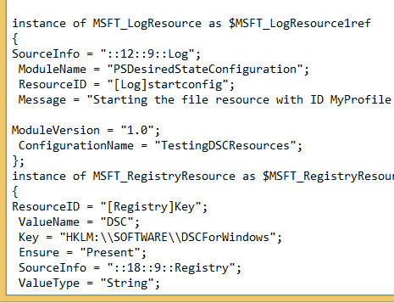
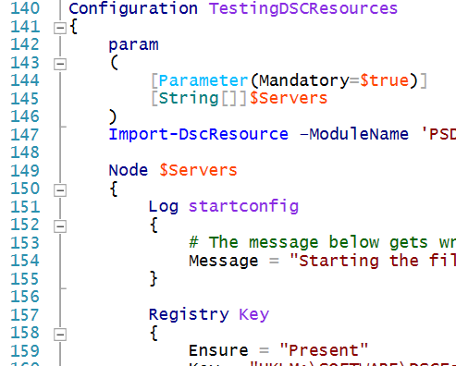
Compilation phase
The DSC configuration file is compiled to an MOF format.
MOF is a Distributed management task force standard for Common Information Model(CIM)
Each MOF file is for a single target node.
You can only have one MOF file applied to
any target node at any given time.
Notes:
The DMTF’s Common Information Model (CIM) provides a common definition of management information for systems, networks, applications and services, and allows for vendor extensions.

Slide 6
Execution phase (LCM)
Previous.mof
New MOF
Pending.mof
Success
Current.mof
Failure
Notes:
- When the LCM executes the MOF successfully, it renames the pending.mof file to current.mof file.
- The execution phase operates the same no matter which deployment mode is in use, push or pull.

Slide 7
Push deployment
LCM
PS
MOF
3rd party tool
Pending.mof
Current.mof
Authoring
Compilation
Execution

Slide 8
Pull deployment
Status
Pull Server
N
N
N
N
PS
Node
MOF
LCM
3rd party tool
MOF Files
Resources
File
download
Pending.mof
Current.mof
Authoring
Staging
Execution

Slide 9
Windows DSC Resources
Process
Built-in resources for:
Enabling or disabling server roles and features
Managing registry settings
Managing files and folders
Starting, stopping and managing processes and services
Managing local user and group accounts
Deploying new software packages
Managing environment variables
Running Windows PowerShell scripts
Archive
Group
Registry
Service
Script
Log
Environment
File
Package
Role
User
Notes:
Describe built-in resources
Tell that there are a lot new resources, xWebAdministation, xSMBshare so on
Tell that we can write own DSC resources if needed
Say about “Windows” resources, because it can be used as well to configure Linux (with DSC module, which call Linux)

Slide 10
DEMO

Slide 11
Used materials
https://www.packtpub.com/books/content/powershell-%E2%80%93-dsc-architecture
https://www.sans.org/reading-room/whitepapers/bestprac/configuration-management-windows-powershell-desired-state-configuration-dsc-36167
https://www.penflip.com/powershellorg/the-dsc-book
https://google.com

